Slide 1
PHD Progression 6
Explainable AI with visual analytics

Slide 2
How Does BERT Answer Questions? A Layer-wise Analysis of Transformer Representations
Proposing a layer-wise visualization of token representations that reveals information about the internal state of Transformer networks
A set of general NLP probing tasks were applied and extended by the QA-specific tasks of question type classification and supporting fact extraction
The third contribution is to show that BERT’s layers go through similar phases even if fine-tuned on different tasks

Slide 3
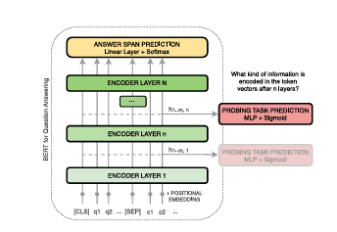
How Does BERT Answer Questions? A Layer-wise Analysis of Transformer Representations
Dimensionality reduction: BERT’s pretrained models use vector dimensions of 1024 and 512. Dimensionality reduction is used to visualize relations between tokens.
K-means Clustering: To verify that clusters in 2D space represent the actual distribution in high dimensional vector space, we apply k-means clustering.
We use principle of Edge probing

Slide 4
How Does BERT Answer Questions? A Layer-wise Analysis of Transformer Representations
We use principle of Edge probing: this translates core NLP tasks into classification tasks by focusing solely on their labeling part.
The research adopts the tasks Named Entity Labeling, Conference Resolution, Relation classification
The researcher also adds question type classification and supporting fact identification due to their importance for question answering.

Slide 5
How Does BERT Answer Questions? A Layer-wise Analysis of Transformer Representations
Named Entity Labeling: This is based on Named Entity Recognition but formulated as a Classification problem
Coreference Resolution: The Coreference task requires the model to predict whether two mentions within a text refer to the same entity.
Relation Classification: In Relation Classification the model has to predict which relation type connects two known entities.
Question Type Classification: A fundamental part of answering a question is to correctly identify its question type.

Slide 6
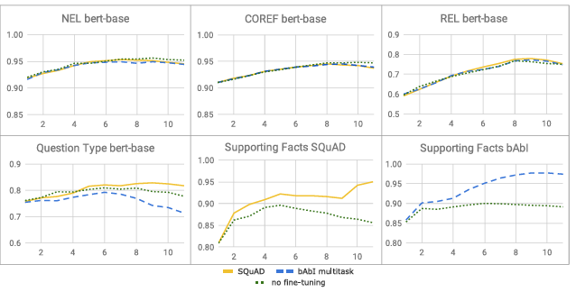
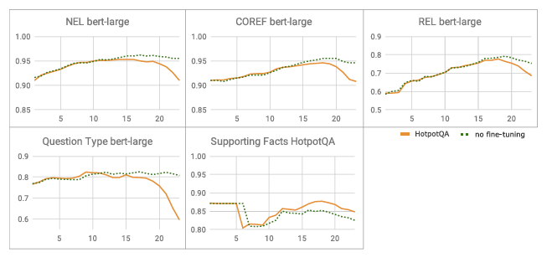
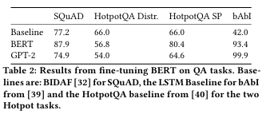
Experiment
SQUAD, HotpotQA and babI dataset
The two models these dataset was tried on was BERT and GPT-2

Slide 7
Results
Semantic Clustering: Early layers within BERT-based models group tokens into topical clusters. This clustering still holds little task-specific information.
Connecting Entities with Mentions and Attributes: In the middle layer, clustering is less connected by their topical similarities. Tokens are connected by their relation to certain input contexts.
Matching Questions with Supporting Facts: Identifying relevant parts of the context is crucial for QA and information retrieval. BERT performs this task by transforming the tokens so that question tokens are matched onto relevant tokens.
Answer Extraction: In the last network layers, the model dissolves most of the previous clusters. It then separates the correct answer token, and sometimes other possible candidates, from the rest of the tokens.

Slide 8
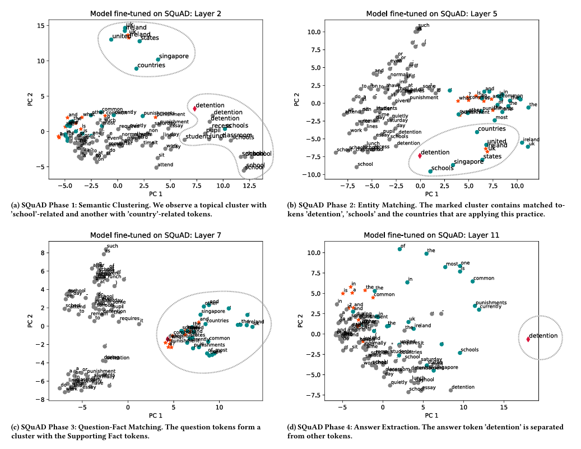
Results

Slide 9
PC1 (Principal Component 1) and PC2 (Principal Component 2) are the primary axes in Principal Component Analysis (PCA), a dimensionality reduction technique
PC1 captures the most variance in data (the longest dimension), while PC2 captures the next most variance, is orthogonal (perpendicular) to PC1, and shows the second-largest spread, allowing complex data to be visualized on a 2D plot to reveal patterns.

Slide 10
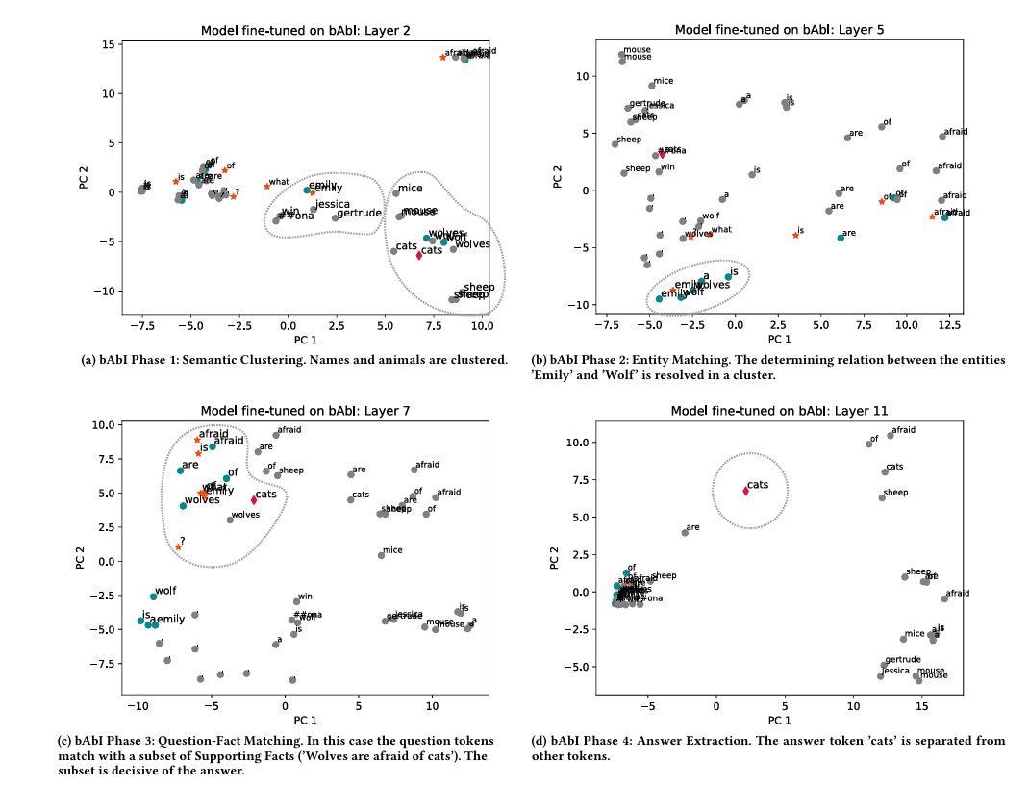
Results

Slide 11
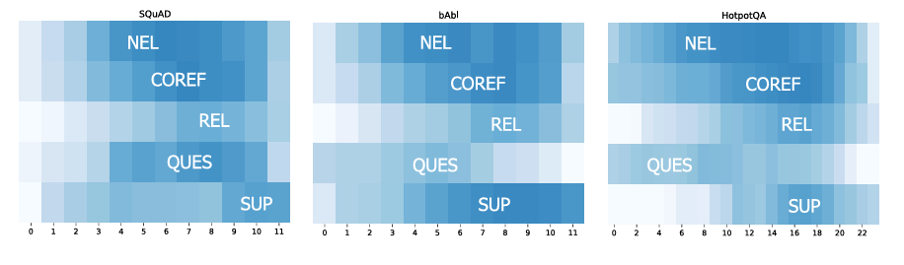
Results

Slide 12
Results
Comparison to GPT-2
Both give particular attention to the first token sequence
Attention is given to the first token in every layer, except for the Embedding layer, the first transformer block, and the last one.
separates the relevant supporting Facts and the question in the vector space
Unlike BERT the final answer is not separated but left as part of the sentence
Possible future research can be done to further probe GPT-2

Slide 13
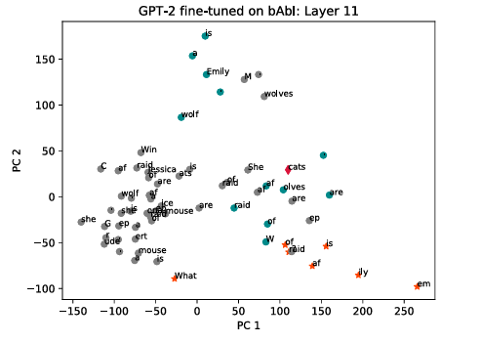
Results
While GPT-2 performs signifi cantly worse in the more difficult tasks of SQuAD and HotpotQA,
it does considerably better on bAbi reducing the validation error to nearly 0. Both tasks require positional or geometric reasoning
it is reasonable to assume that this is a skill where GPT-2 improves on BERT’s reasoning capabilities.
https://visbert.demo.datexis.com/

Slide 14
AttentionVIZ
The goal of this study is to understand the self-attention mechanism of transformers
previous techniques generally visualize information related to just a single input sequence at a time.
The primary technique of this research is visualizing a joint embedding of the query and key vectors used by transformers.

Slide 15
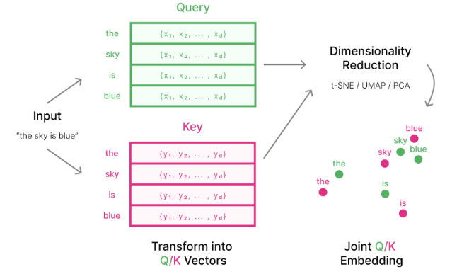

AttentionVIZ
An effective method to visualize multiple inputs is to visualize a collection of embedded vectors from multiple input sequences.
Each attention transformer head turns input embedding into query vectors and key vectors by applying matrices $W_{Q} and W_{K}$
These matrices then project the vector embedding to a lower dimensional space, getting only specific information from the higher-dimensional vector embedding

Slide 16
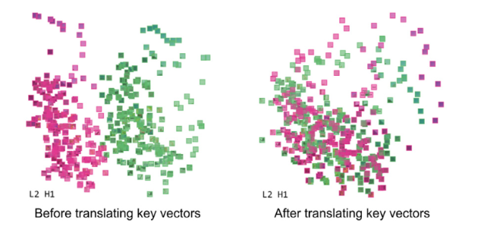
AttentionVIZ
attention coefficients depend on the dot product between queries and keys, Closer distance directly shows higher attention coefficients.
the relationship between dot product and distance is not precise, as query and key vary in norm
Vector normalization is applied prior to dimensionality reduction; this is to tune the ‘free parameters’ and create a closer relationship between embedding distance and attention weights (SoftMax function)

Slide 17
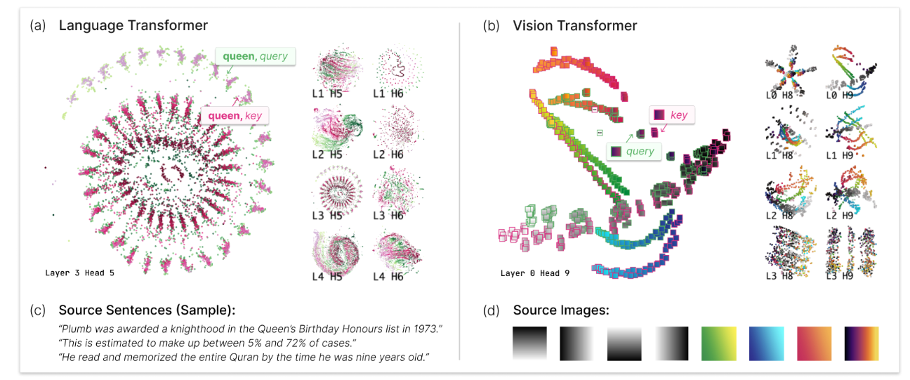
AttentionVIZ
we obtain the key and query vector representation of each token in each sentence, then use dimensionality reduction techniques such as t-SNE, UMAP or PCA to project the high-dimensional vector into low-dimensional space.
This attentionVIZ is used for language and vision transformers
It's important to note that each dimensionality reduction technique will produce different patterns.

Slide 18
AttentionVIZ: views and interactivity
Attentionviz offers various color customizations for token types (key or query). For vision transformers, users can color by image patch row or column to visualize positional patterns. For language models, color options are normalized and discrete.
This research framework provides three interactive views, Matrix view, single view, and sentence/Image view.

Slide 19
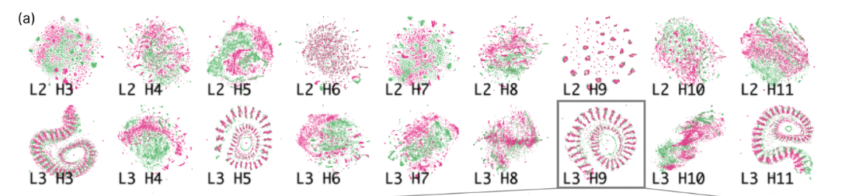
AttentionVIZ: views and interactivity
In GPT-2 average query norm was different from average key norm, causing query to appear as small clusters, surrounded by loose cloud of keys.
Both key and query tokens are scales by C
Matrix view uses small multiples to visualize the attention heads in the transformer at once. Each row corresponds to a model layer. This provides a Global perspective that users can easily scan for patterns across different transformer layers and heads.

Slide 20
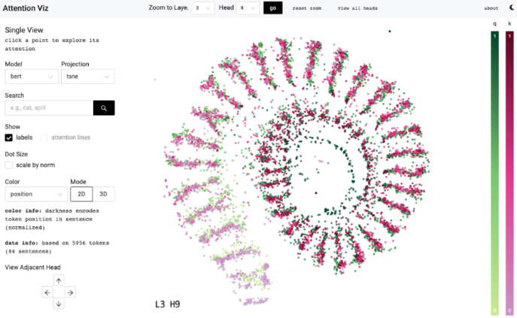
AttentionVIZ: views and interactivity
Single view, any plot in the matrix view can be clicked on to zoom into a single view, which allows the exploration of a single attention head in closer detail. It allows for the same customizations available in Matrix view. Users also have the option to project attention lines onto the scatterplots, which connect query and key tokens, and show only the top two attention weights for readability.

Slide 21
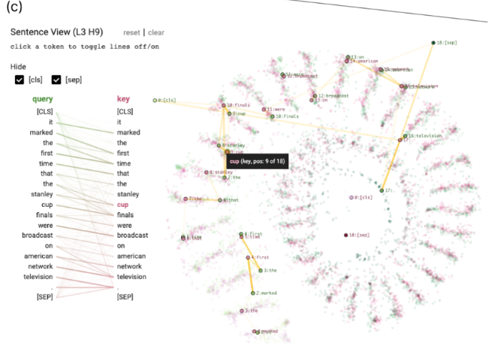
AttentionVIZ: views and interactivity
Sentence view: When using BERT or GPT-2 users can click on a point in single view to open sentence view in the left sidebar, which displays BertViz-inspired visualization of sentence-level attention with the clicked token highlighted, bipartite approach offers the best readability. The opacity of connecting query tokens to key tokens shows the strength of attention.
Hovering over a token highlights a token-specific attention line. To reduce noise from classification tokens and separators, attention lines can be hidden.

Slide 22
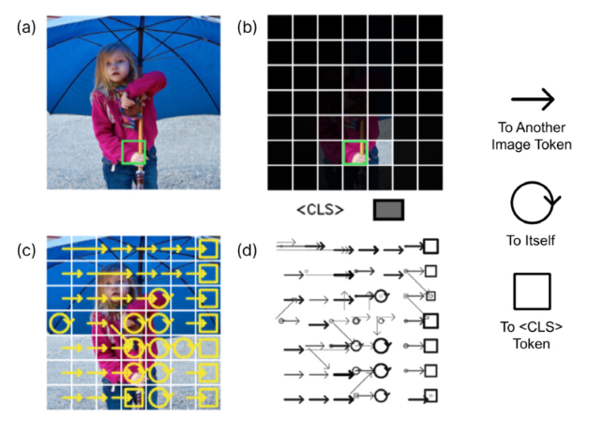
AttentionVIZ: views and interactivity
Image view: For image-based input in ViT, when an image patch is clicked on, the clicked token is highlighted with colored border, users also see an image overlaid with an attention heatmap, transparency indicates the attention weight between the clicked image patch and other regions of the image.
The overall attention pattern within an image can also be explored by showing arrowed lines between different image patches.
There are two options available for visualizing attention arrows; the first option overlays heatmap on the top of the original image patches, with transparency indicating the attention weight between clicked image patch and other regions.
The second option shows the attention pattern of the whole image.

Slide 23
AttentionVIZ: Findings and Evaluation
Experts in the field were invited to evaluate the tool and its results
We were curious if any visual attention heads specialize in either color-based and brightness-based patterns. PCA patterns in the matrix view, showed two attention heads that resemble color and colorless vision
Tokens pay the most attention to other tokens with the same color or brightness

Slide 24
AttentionVIZ: Findings and Evaluation
They identified an attention head that separates image tokens based on their spatial pattern’s frequencies and angles (similar shapes and angles paid attention to each other).
Self attention attends more broadly across images in deeper layers of vision transformers
Unlike CNN which processes images using square filter, the self-attention mechanism in transformers often processes images row by row and column by column, analogous to an elongated filter.

Slide 25
AttentionVIZ: Findings and Evaluation
They identified that plots with spirals and clump tokens encode positional patterns; token position increases as we move from the outside to the inside of the spiral.
The difference between spirals and clumps appear to be whether token attends selectively to others one position away, vs several different positions
Heads with high query-key overlap. Tokens typically attend to themselves and other instances of the same token

Slide 26
AttentionVIZ: Findings and Evaluation
Earlier layers have more have the most information about linear word order
Mid-to-later model layers contains syntactic and task-specific information; for instance, later layers have query-key sandwich, where keys and queries at the beginning of text are stacked, followed by being in reverse order at the end of the text.

Slide 27
AttentionVIZ: Findings and Evaluation
An overview of the global search pattern shows that patterns in clumps and spirals have more dispersed search results, indicative of their underlying positional attention patterns. Heads with the “look at self” attention pattern only have one cluster of search results, emphasizing the strong interaction between query and keys
Even when there was no distinctive shape, if there were a few search result clusters, the head may display more semantic behavior.

Slide 28
AttentionVIZ: identifying anomalies and unexpected Behaviour
In GPT-2 they noticed large disparity in the norm of query and key, there was no explanation for this, how ever a paper published points to out-of-control query and key norms as cause of training instability.
In many GPT-2 heads, attention was mostly directed to the first token, especially in the later layers
Self attending attention heads

Slide 29
Supervisors Feedback
Look at attentionviz, study it more
Understand and try to implement a new document with visBERT
What are keys and query
Find where the model is and how it’s implemented
How dimensionality reduction is applied to the model
Push to GitHUB and send to Dr. Gopal

